Slide 1


Engineering Self-Organization: From Networking to Synthetic Biology
Jacob Beal
Dagstuhl Seminar 15402: Self-assembly and Self-organization in Computer Science and Biology
September, 2015

Slide 2
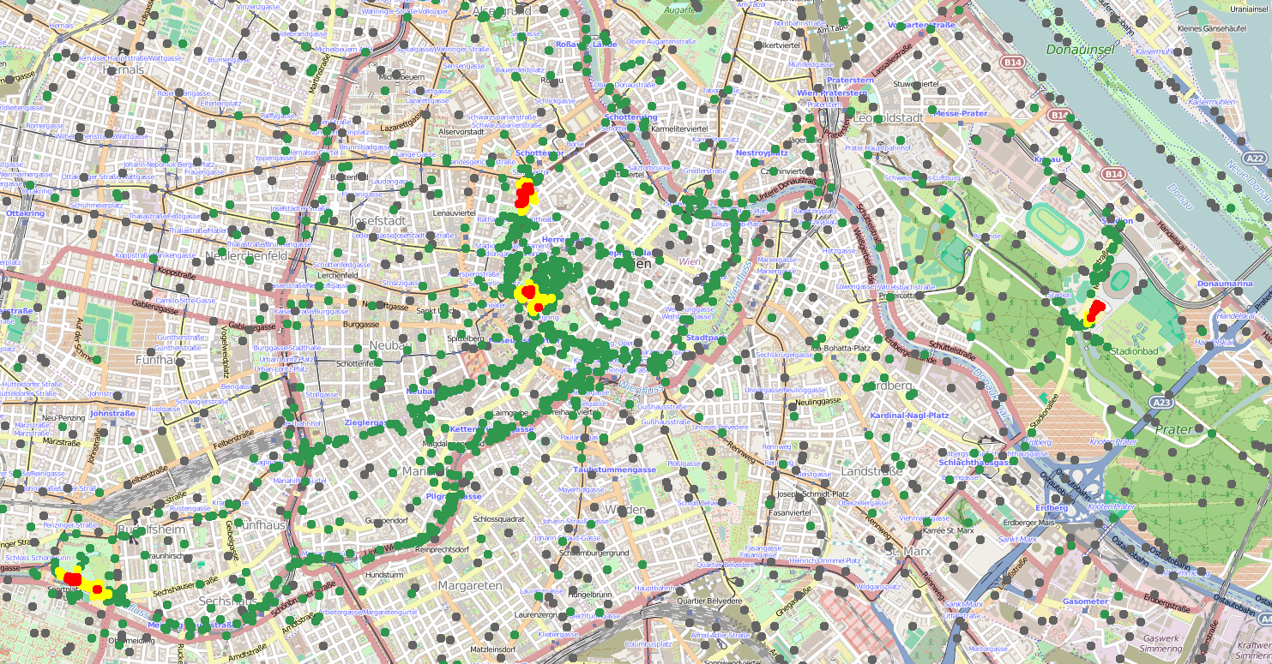
Engineering Aggregates
Aggregate Programming
Synthetic Biology Analytics & Design
Field Calculus, Spatial Computing
Calibrated Flow Cytometry
Spatial Patterning
Resilient Networking
Precision Organism Engineering
High-Performance Devices
U6
gRNA-a
pConst
cas9m-BFP
CRa-U6
EYFP
Beal et al., Computer, 2015,
Beal & Bachrach, IEEE Int.Sys. 2006,
Beal & Bachrach, SCW, 2008
Kiani et al., Nat. Meth., 2014,
Beal et al., ACS Syn.Bio., 2012,
Beal et al., ACS Syn.Bio., 2014

Slide 3
Aggregate Programming
Restrict your development environment…
… to contain only resilient distributed systems.

Slide 4
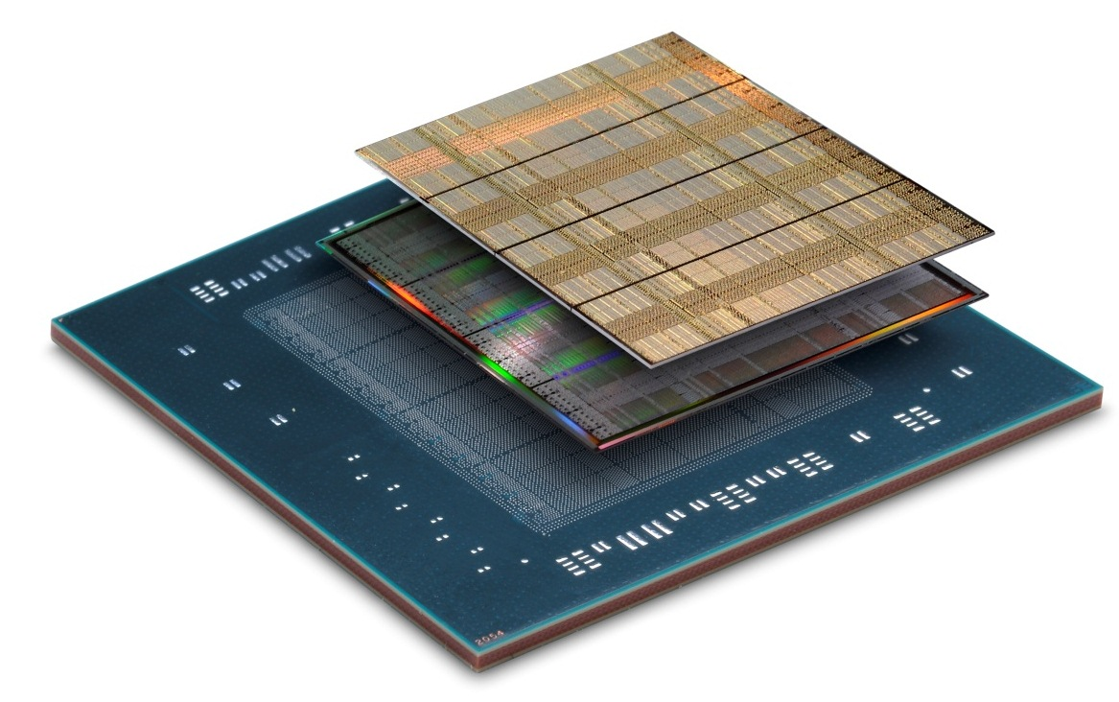
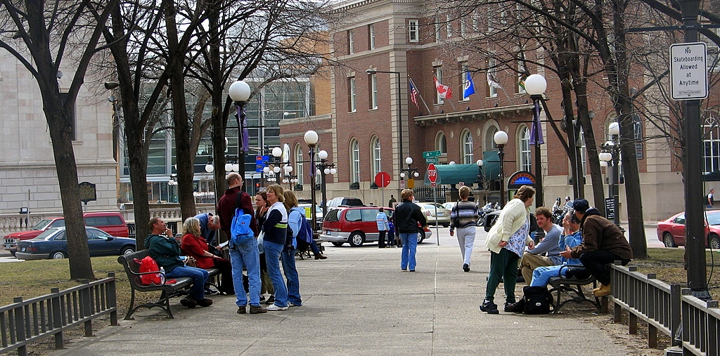
Dealing with challenging platforms
Emerging Computational Platforms
Computational Field
Programming Models
Inherently Resilient
Distributed Systems
device
neighborhood
Pay a little efficiency, get a lot of programmability and resilience

Slide 5
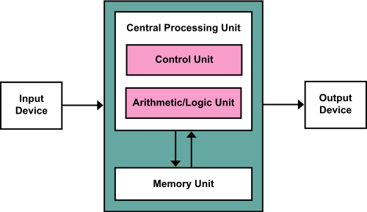
Traditional Monolithic Computing
The venerable von Neumann model is
breaking down in several ways…

Slide 6
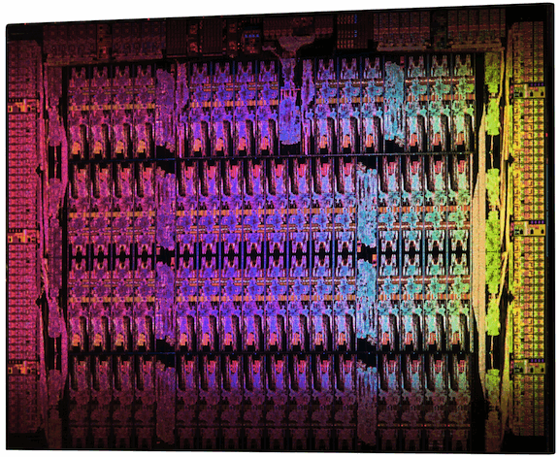
The End of Moore’s Law
Intel Xeon Phi: 61 cores
Xilinx Virtex-7: 2M Logic cells
High-performance computing = mesh

Slide 7
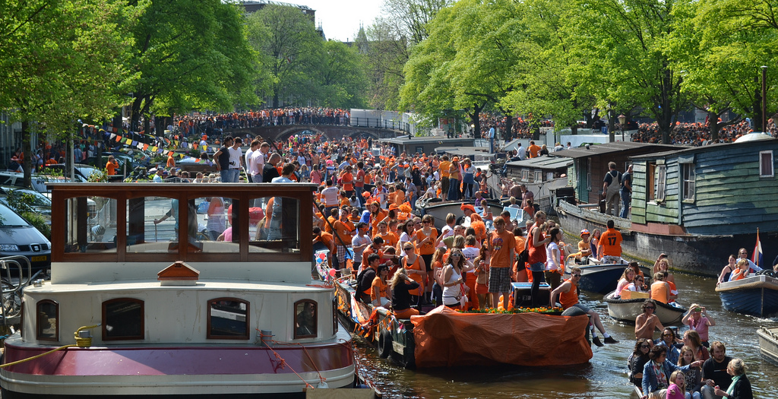
Networked Devices Everywhere

Slide 8
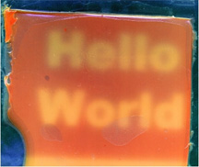
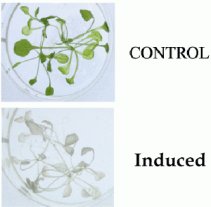
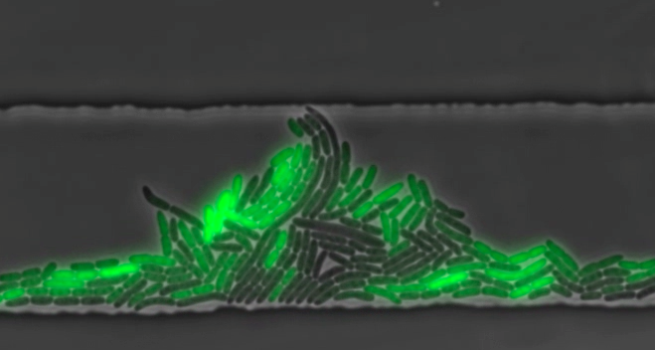
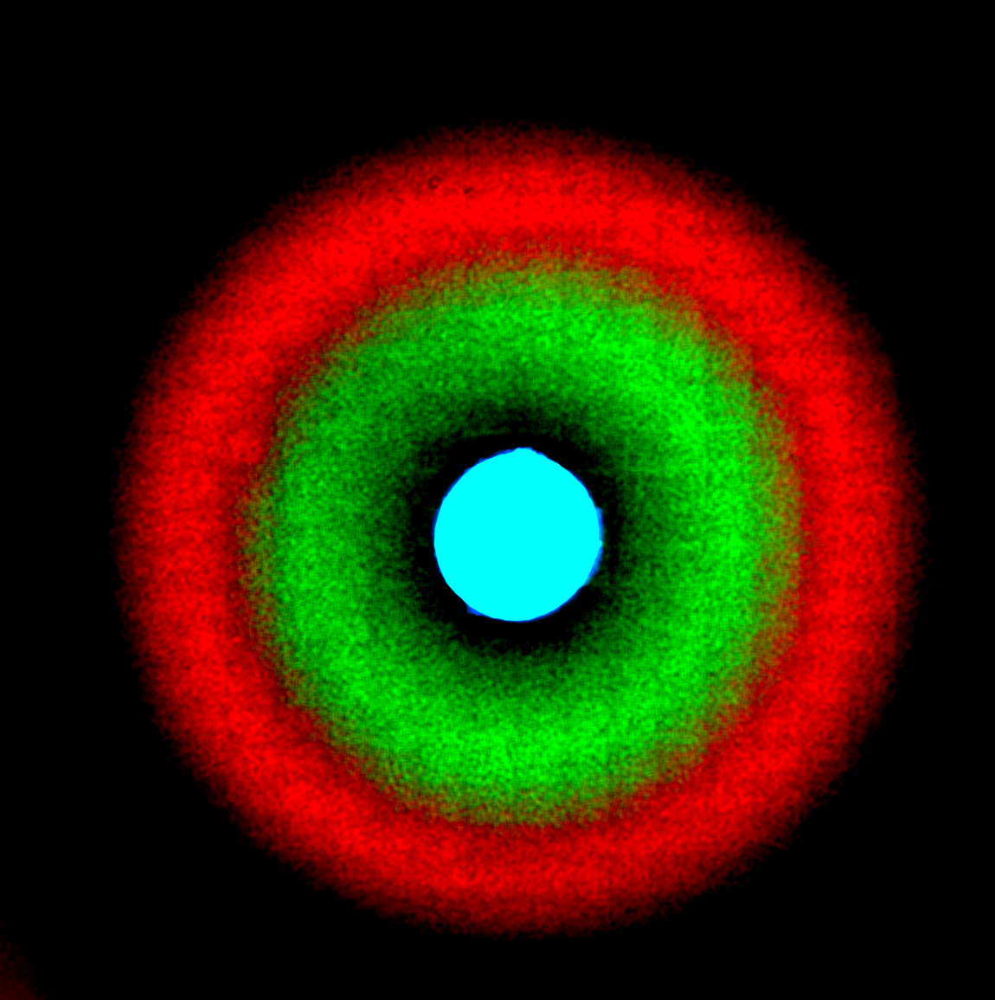
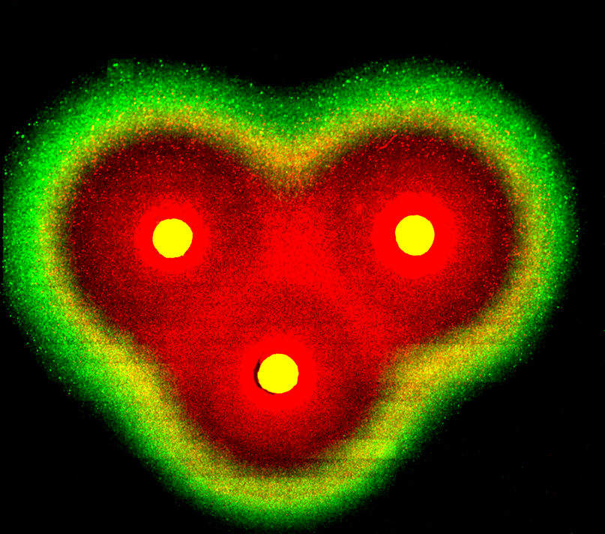
New Computational Materials
Synthetic Biology:
[Levskaya]
[Weiss]
[Medford]
[Hasty]
Other emerging areas too, including nanoassembly, active materials…

Slide 9

Fundamentally different models
Isolate Systems
Extremely High FLOPs
High Dispersion
Moderate FLOPs
High Resolution Sense/Act
Abysmal FLOPs
How can we program aggregates adaptively & efficiently?
Are there commonalities that cross substrates?
Notes:
(e.g., biosensors talk bootstrap off cheap wireless talks to talk to cloud computation

Slide 10

Device-Centric Programming
Dispersal Advice
Congestion-Aware Navigation
Dangerous Density Warning
Crowd Estimation
Explicit design of adaptation and communication
Complex per-device multi-service application
Intractable to ensure correct behavior

Slide 11
Aggregate Programming
Dispersal Advice
Congestion-Aware Navigation
Dangerous Density Warning
Crowd Estimation
Implicit adaptation and communication
Code each collective service independently
Compose via scope and information flow

Slide 12
Aggregate Programming Stack

Slide 13
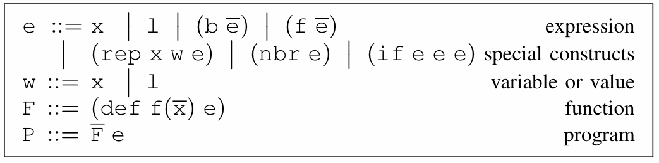
Field Calculus
State
Variable
Literal Value
Local Ops
Communication
Domain Change
Abstract & Call
Functions
[Viroli et al., ‘13, Damiani et al., ‘15]

Slide 14
Aggregate Programming Stack

Slide 15
Self-Stabilizing Building Blocks
G
Information spreading
C
Information collection
T
Short-term memory
4
3
1
7
1
3
3
0
2
Resilience by construction: all programs from these building blocks are also self-stabilizing!
[Beal & Viroli, 2014]

Slide 16
Applying building blocks:
Example API algorithms from building blocks:
distance-to (source) max-likelihood (source p)
broadcast (source value) path-forecast (source obstacle)
summarize (sink accumulate local null) average (sink value)
integral (sink value) region-max (sink value)
timer (length) limited-memory (value timeout)
random-voronoi (grain metric) group-size (region)
broadcast-region (region source value) recent-event (event timeout)
distance-avoiding-obstacles (source obstacles)
Since based on these building blocks, all programs built this way are self-stabilizing!

Slide 17
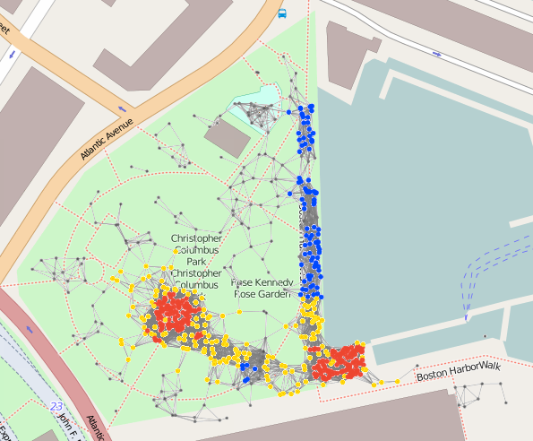
Complex Example: Crowd Management
(def crowd-tracking (p)
;; Consider only Fruin LoS E or F within last minute
(if (recently-true (> (density-est p) 1.08) 60)
;; Break into randomized ‘‘cells’’ and estimate danger of each
(+ 1 (dangerous-density (sparse-partition 30) p))
0))
(def recently-true (state memory-time)
;; Make sure first state is false, not true...
(rt-sub (not (T 1 1)) state memory-time))
(def rt-sub (started s m)
(if state 1 (limited-memory s m)))
(def dangerous-density (partition p)
;; Only dangerous if above critical density threshold...
(and
(> (average partition (density-est p)) 2.17)
;; ... and also involving many people.
(> (summarize partition + (/ 1 p) 0) 300)))
(def crowd-warning (p range)
(> (distance-to (= (crowd-tracking p) 2))
range)
(def safe-navigation (destination p)
(distance-avoiding-obstacles
destination (crowd-warning p)))
18 lines non-whitespace code
10 library calls (21 ops)
IF: 3 G: 11 C: 4 T: 3

Slide 18
Optimization of Dynamics
[Viroli et al., ‘15]

Slide 19
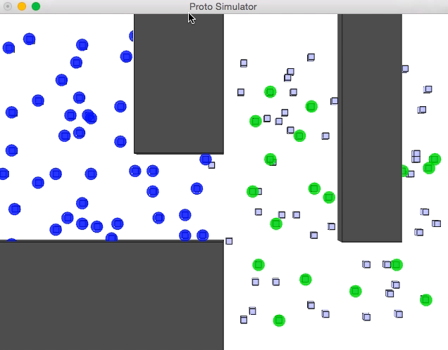
Optimization Example: Crowd Alert
Naïve algorithm: when stationary, fine…

Slide 20
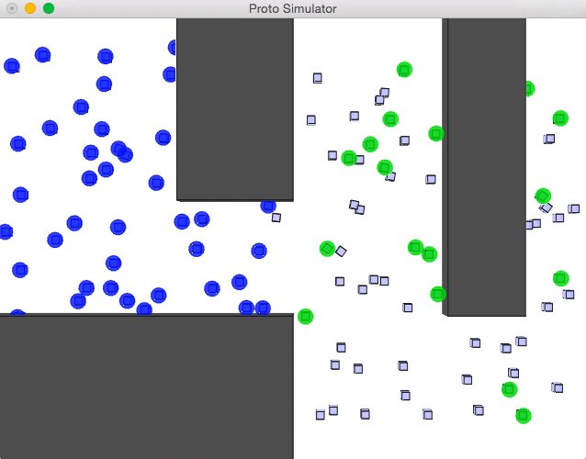
Optimization Example: Crowd Alert
… but dynamics can’t keep up with fast mobility.

Slide 21
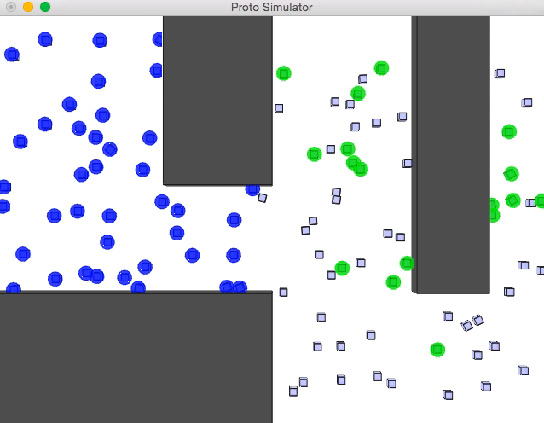
Optimization Example: Crowd Alert
Optimized dynamics, however, work well.

Slide 22
Aggregate Programming Stack

Slide 23
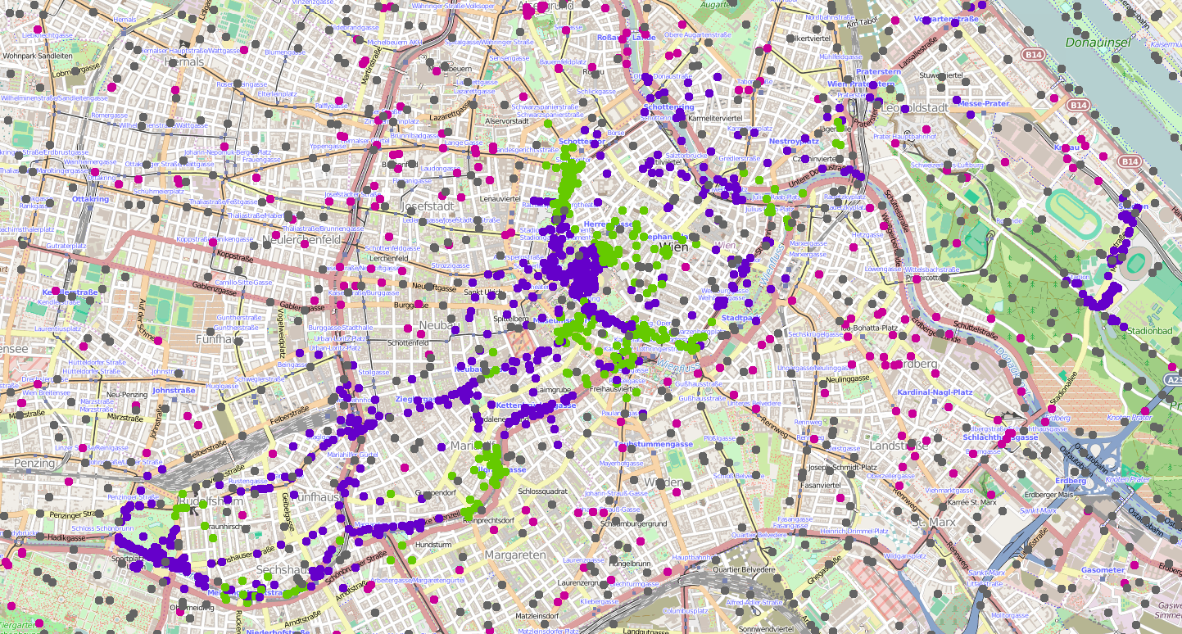
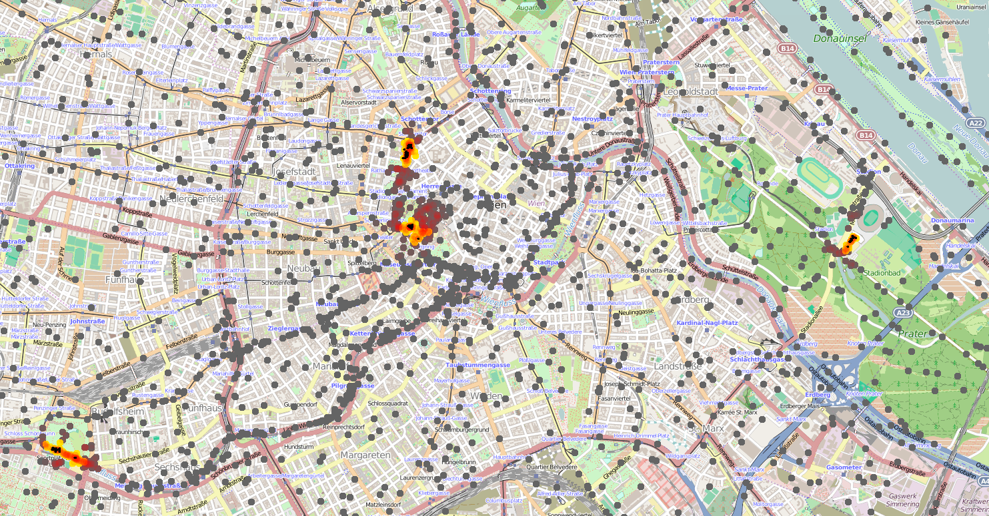
Crowd Safety Services
^{def dangerousDensity(p, r) {}
let mr = managementRegions(r*2, () -> { nbrRange });
let danger = average(mr, densityEst(p, r)) > 2.17 &&
summarize(mr, sum, 1 / p, 0) > 300;
if(danger) { high } else { low }
}
^{def crowdTracking(p, r, t) {}
let crowdRgn = recentTrue(densityEst(p, r)>1.08, t);
if(crowdRgn) { dangerousDensity(p, r) } else { none };
}
def crowdWarning(p, r, warn, t) {
distanceTo(crowdTracking(p,r,t) == high) < warn
}
Dissemination of new versions
Pre-emptive modulation of priorities

Slide 24
Dependency-Directed Recovery
Dramatically better recovery time
Identify & shut down
affected services
Non-dependent
services still run
Fewer services disrupted
[Clark et al., 2015]

Slide 25
Summary: Aggregate Methodology
restrict

Slide 26
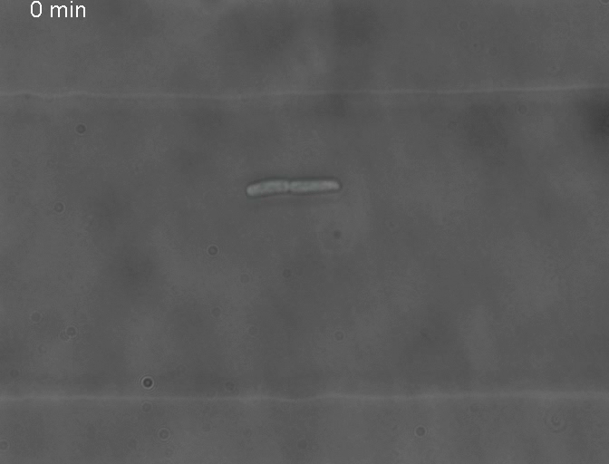
Now let’s go to biology…
[Stricker et al., 2008]

Slide 27
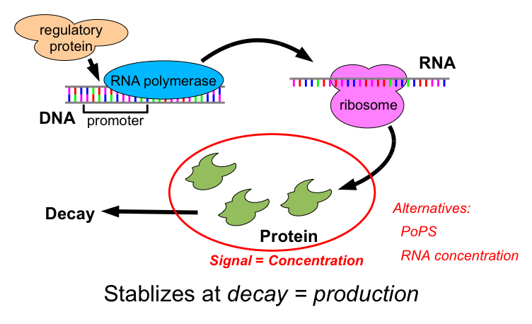
Transcriptional Logic Computations

Slide 28
Simple Circuit Example
Ara
AraC
pBAD
GFP
pBAD
TetR
pTet
RFP
“Off”
“On”

Slide 29
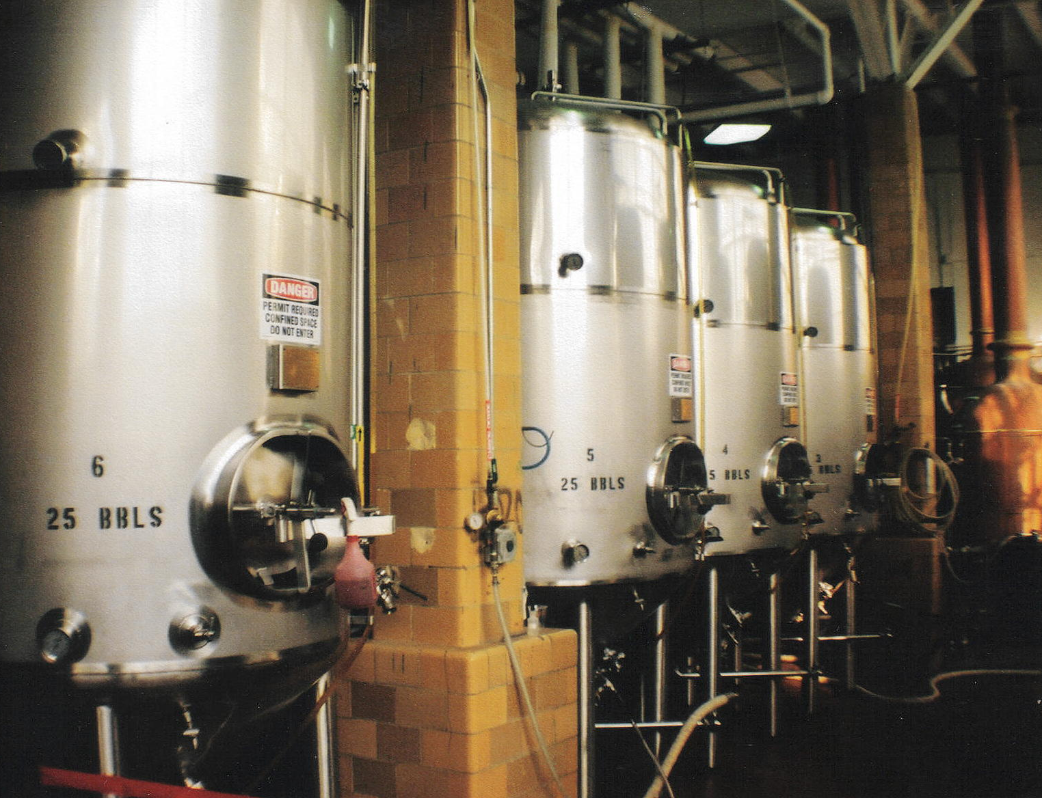
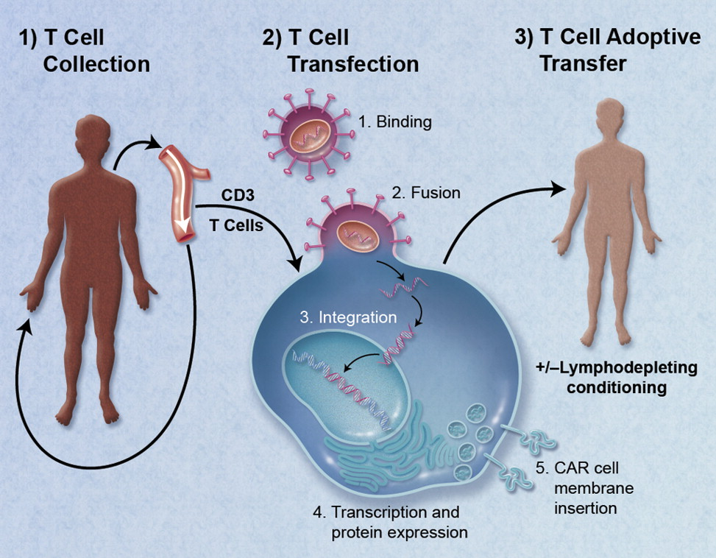
Application Examples
Fermentation control
CAR T-cell Therapy

Slide 30


High-Level Genetic Circuit Design
Make drug when Arabinose shows up before IPTG

Slide 31
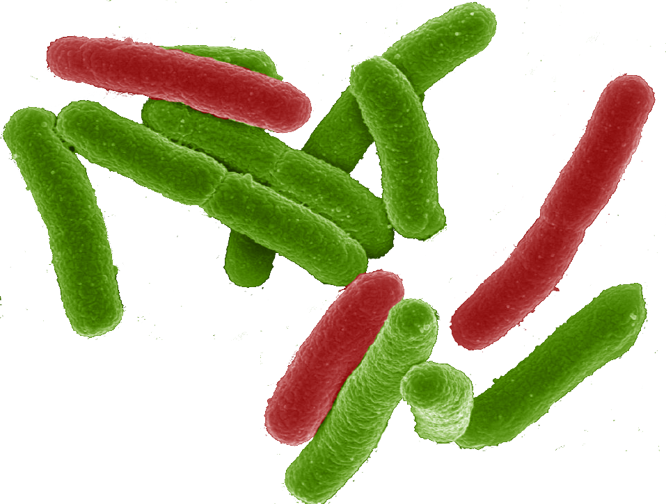

Why a tool-chain?
Organism Level Description
This gap is too big to cross with a single method!
Cells

Slide 32
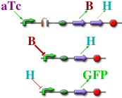
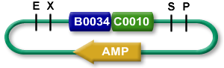

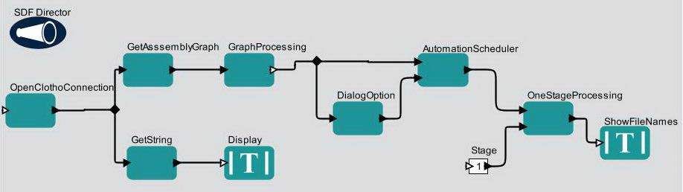

TASBE tool-chain
Organism Level Description
High level simulator
High Level Description
If detect explosives:
emit signal
If signal > threshold:
glow red
Coarse chemical simulator
Abstract Genetic Regulatory Network
Detailed chemical simulator
DNA Parts Sequence
Modular architecture also open for flexible choice of organisms, protocols, methods, …
Collaborators:
Assembly Instructions
Ron
Weiss
Testing
Douglas Densmore
Cells
[Beal et al, ACS Syn. Bio. 2012]

Slide 33
A Tool-Chain Example
A high-level program of a system that reacts depending on sensor output
If detect explosives:
emit signal
If signal > threshold:
glow red
(def simple-sensor-actuator ()
(let ((x (test-sensor)))
(debug x)
(debug-2 (not x))))
Mammalian Target
E. coli Target
[Beal et al, ACS Syn. Bio. 2012]

Slide 34
A Tool-Chain Example
Program instantiated for two target platforms
If detect explosives:
emit signal
If signal > threshold:
glow red
Mammalian Target
E. coli Target
[Beal et al, ACS Syn. Bio. 2012]

Slide 35
A Tool-Chain Example
Abstract genetic regulatory networks
If detect explosives:
emit signal
If signal > threshold:
glow red
Mammalian Target
E. coli Target
[Beal et al, ACS Syn. Bio. 2012]

Slide 36
A Tool-Chain Example
Automated part selection using database of known part behaviors
If detect explosives:
emit signal
If signal > threshold:
glow red
Mammalian Target
E. coli Target
[Beal et al, ACS Syn. Bio. 2012]

Slide 37
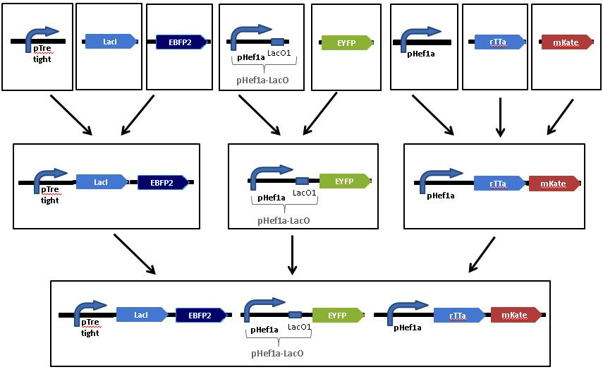
A Tool-Chain Example
Automated assembly step selection for two different platform-specific assembly protocols
If detect explosives:
emit signal
If signal > threshold:
glow red
Mammalian Target
E. coli Target
[Beal et al, ACS Syn. Bio. 2012]

Slide 38
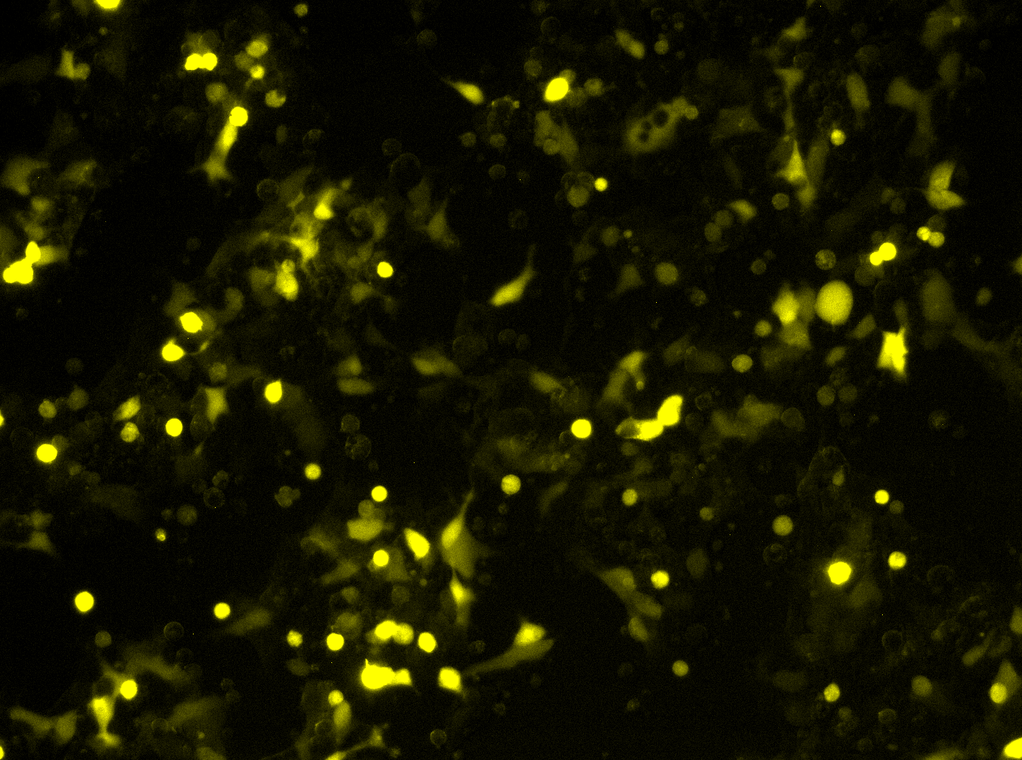
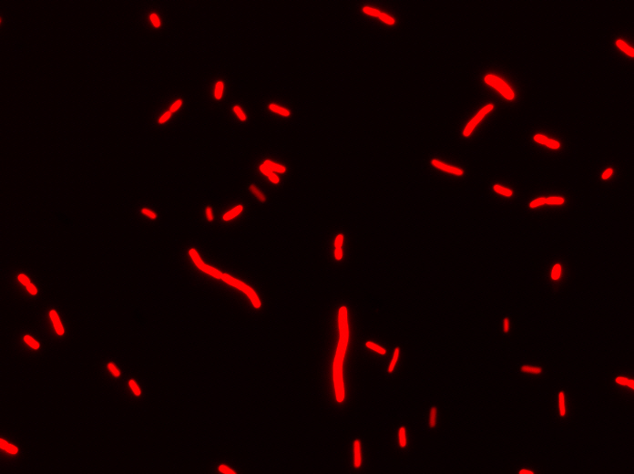
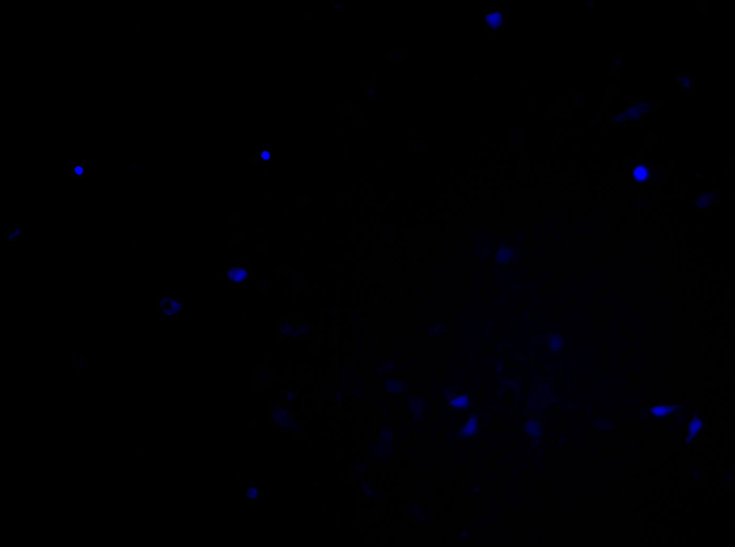
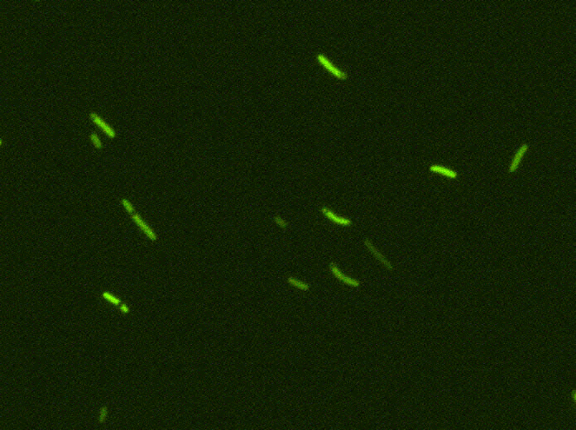
A Tool-Chain Example
Resulting cells demonstrating expected behavior
Uninduced
Uninduced
If detect explosives:
emit signal
If signal > threshold:
glow red
Induced
Induced
Mammalian Target
E. coli Target
[Beal et al, ACS Syn. Bio. 2012]

Slide 39
The Tool-Chain Approach:
Organism Aggregate Description
Proto
BioCompiler
High level simulator
Single-Cell Description
If detect explosives:
emit signal
If signal > threshold:
glow red
[Beal et al, PLoS ONE 2011]
Coarse chemical simulator
Alternate 2nd stages:
SBROME, CELLO, GEC, …
Abstract Genetic Regulatory Network
Gap!
Detailed chemical simulator
DNA Parts Sequence(s)
Assembly Instructions
Next-Gen Synthesis,
Organick, Antha, MAGE,
microfluidics, …
Testing
Cells

Slide 40
Complex Designs: Barriers & Emerging Solutions
Barrier: Characterization of Devices
Emerging solution: TASBE characterization method
Barrier: Availability of High-Gain Devices
Emerging Solution: combinatorial device libraries based on CRISPR, TALs, miRNAs, recombinases, …
Barrier: Predictability of Biological Circuits
Emerging solution: EQuIP prediction method

Slide 41

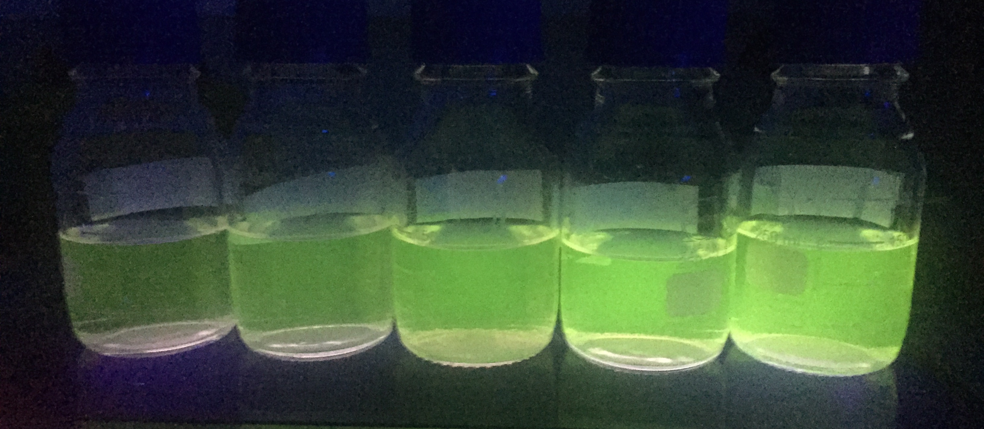
Characterization & reproducibility
iGEM Interlab Study:
Build three constitutive GFP constructs
Culture & measure fluorescence
3 biological replicates (Extra: x 3 technical rep.)
Negative
(e.g. R0040)
J23117
+ I13504
Positive
(e.g. I20270)
J23106
+ I13504
J23101
+ I13504
Image from iGEM Oxford 2015

Slide 42
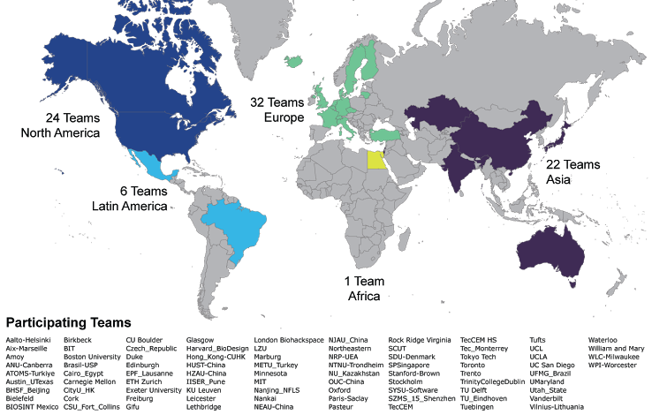
2015 iGEM Interlab Study Participation

Slide 43
High sensitivity to protocol
2014: J23101 (High) vs. I20260 (Med)
2015: J23101 (High) vs. J23106 (Med)
2014:
2.2-fold Std.Dev.
2015:
1.5-fold Std.Dev.!
Team
Team
More specific protocol → tighter distributions

Slide 44
Instrument issues drive variation!
Strain
Instrument
1000
1000
100
100
10
10
1
1

Slide 45
Calibrated Flow Cytometry
[Roederer, 2002; Wang et al., 2008; NIST/ISAC, 2012; Beal et al., 2012; Kiani et al., 2014; Beal et al., 2014; Davidsohn et al, 2014]

Slide 46
CRISPR Repressor Devices
CRISPR system can be used to create high-performance repressors, large libraries
gRNA
Cas9m
Transcription initiation complex
RNA Pol-II
Gal4VP16
x
Mini-CMV
x
EYFP
Poly(A)
5xUAS
gRNA
Example: CRISPR cascades
Cas9m
U6/gRNA-a
CRa-U6/gRNA-b
CRP-b/EYFP
Stage 1
Stage 2
Stage 1
[Kiani et al, Nat.Meth. 2014]
Stage 2
V1
V1
V2
V2
V3
V3

Slide 47
Example: Predicting Repressor Cascades
Precision dose-response measurement allows high-precision prediction with quantitative models
Dox
pCAG
rtTA3
T2A
VP16Gal4
pTRE
EBFP2
pCAG
R1
R2
EYFP
pCAG
mkate
pTRE
pUAS-Rep1
pUAS-Rep2
Prediction of Repressor Cascade
Range vs. Error for 6 Cascades
TAL14 → TAL21
+: experimental
o: predicted
Each line is a dose/response curve for a different relative number of circuit copies.
Subpopulation identified by color on inset mKate histogram
[Davidsohn et al., 2014]

Slide 48
Example: Engineering Replicon Expression
Per-cell measurement of dose-response gives model allowing high-precision control of expression
Example:
Prediction of fluorescence vs. time for novel mixtures of 3 Sindbis RNA replicons
nsP1-4
SGP
mVenus
Mix 1: 0.1Y, 0.1R, 0.1B
Mix 2: 0.3Y, 0.3R, 0.3B
Mix 3: 0.1Y, 0.5R, 0.4B
Mix 4: 0.2Y, 0.2R, 0.6B
Mix 5: 0.01Y, 0.1R, 0.5B
Mix 6: 0.4Y, 0.02R, 0.02B
nsP1-4
SGP
mKate
nsP1-4
SGP
EBFP2
Example Prediction of 3-RNA Replicon Mix:
Range vs. Error for 6 Mixtures
Mix Number
[Beal et al., 2014]

Slide 49
Summary
Aggregate programming maps from global specifications to local interaction rules
Field calculus, building block libraries, and substitution relations allow efficient engineering
Aggregate programming can also be applied to engineering of biological organisms
New biological devices, measurement, and modeling are starting to enable complex designs

Slide 50








Acknowledgements:
Aaron Adler
Joseph Loyall
Rick Schantz
Fusun Yaman
Shane Clark
Partha Pal
Kyle Usbeck
Ron Weiss
Jonathan Babb
Noah Davidsohn
Mohammad Ebrahimkhani
Samira Kiani
Tasuku Kitada
Yinqing Li
Ting Lu
Douglas Densmore
Evan Appleton
Swapnil Bhatia
Chenkai Liu
Viktor Vasilev
Tyler Wagner
Traci Haddock
Kim de Mora
Meagan Lizarazo
Randy Rettberg
Markus Gershater
Marc Salit
Sarah Munro
Soura Dasgupta
Raghu Mudumbai
Amy Kumar
Mirko Viroli
Danilo Pianini
Ferruccio
Damiani
Jim Hollenhorst
Zhen Xie

